Slide 1
Precise Time-synchronization in the Data-Plane using Programmable Switching ASICs
Pravein Govindan Kannan Raj Joshi Mun Choon Chan

Slide 2
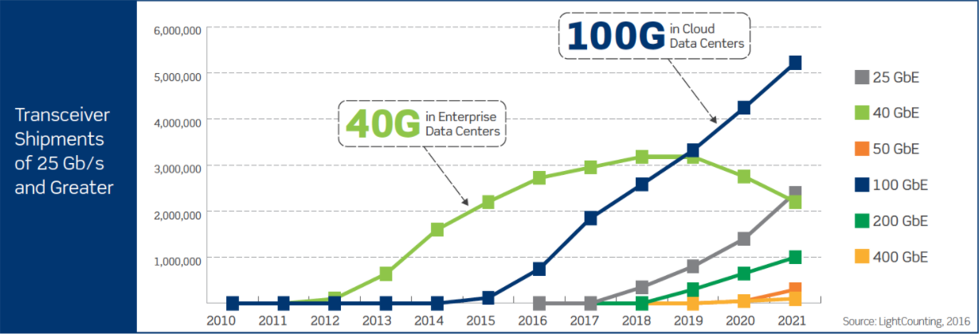
Need for Time-synchronization in Data-centers
Data-center Speeds
Data-center appetite for 100G/400G is increasing!!
At 100G speeds, an 80-byte packet every 6.4ns.
Distributed Applications
Nanosecond-level Time synchronization is essential!!
High-speed Trading
E-Commerce
Network Scheduling/ Updates
Etc..
Notes:
Data-center network speeds are moving to 100Gs and 400G in the upcoming years
With 100G speeds, an 80-byte packet is received every 6.4ns.
With applications like high-speed trading, ecommerce and network management tasks relying on ordering of events to maintain consistency and performance, nanosecond-level time synchronization is essential in data center networks.

Slide 3
Challenges
Variable / Unaccountable
Network Delays
t0
t1
CPU Scheduling delays
t2
t3
Client
Server
(Masterclock)
Clock Drifts
upto 30µs/Sec [NSDI’18]
Calculated Time = Reference Time + P$ropagation Delay$
P$ropagation Delay=\frac{(t3 −t0) −(t2 −t1)}{2}$
Notes:
So, why is nanosecond level clock synchronization a challenge?
Consider a two hosts in the network, one Master host maintains the reference time. When a client receives the time from the master, it has to calculate the current time using the reference time and the propagation delay for the time synchronization packet.
It sounds simple, but in reality, This process is affected by various challenges:
First, the variable and unaccountable network delays, which makes it impossible to get an accurate estimate of one-way propagation delay.
Second, the variable CPU scheduling delays, which delays the sending/reception of the time-synchronization packets..
Finally, Clock drifts over time, worst case of 30microsends/second as reported by HUYGENS this year. Hence, this process has to be repeated continuously in order to maintain the error from clock drifts

Slide 4
Existing Work
NTP, PTP, HUYGENS[NSDI ’18]
End-to-End Host based Implementation.
Affected by variable delays.
NTP uses statistical corrections.
Sub-ms
PTP uses hardware timestamping, network feedback.
Ns to sub-us
HUYGENS uses coded probes , SVM filtering technique.
Sub-ns
Higher traffic overhead.
Synchronize End-hosts CPU & NiC!!
Notes:
Existing standards such as NTP, PTP and a recent work HUYGENS
Are end-to-end host based implementations, which are affected by the aforementioned challenges.
NTP uses statistical corrections to estimate one-way propagation delay and it achieves only sub-millisecond synchronization.
PTP relies on hardware timestamping and network feedback on delays. Under heavy network load conditions PTP achieves sub-us synchronization.
HUYGENS uses coded probes and SVM filtering techniques to estimate one-way delay, and it achieves nanosecond –level synchronization. However, it does it at the cost of higher traffic overhead due to control probes.
Existing works have mainly looked at synchronizing end-host CPUs or Nics.

Slide 5
Emergence of In-Network Computing
Distributed Services / Applications
NetChain (NSDI ’18, Best Paper)
NetCache (SOSP ’17)
IncBricks (ASPLOS ‘17)
Co-designing Distributed Systems with Network support
NetPaxos (SOSR ’15)
Speculative Paxos (NSDI ’15, Best Paper)
NOPaxos (OSDI ’16)
Eris (SOSP ‘17)
Several Others
Synchronized Network Snapshots (SIGCOMM ’18)
In-band Network Telemetry (INT)
Time synchronization is needed in dataplane!!
Notes:
The emergence of Prgrammable switching ASICs have given rise to a new direction of research called “In-Network computing” with novel distributed applications being offloaded to the network. Switches.
With this new paradigm, time-synchronization is much needed in the network dataplane, apart from the end-hosts CPUs.

Slide 6
Programmable Switching ASICs
Configurable Header Parsing & TCAM, SRAM Match-Action Tables
Stateful Memory (Registers)
Precise Nanosecond-level timestamps at various switch stages
Notes:
Programmable Switching ASICs provide flexible header parsing & configuratable match-action tables, in addition to stateful transactional memory units.
Programmable switching ASICs also provide precise nanosecond-level timestamps taken at four different stages in the switch
when a packet received, when a packet enters ingress/egress pipeline and finally, when the packet is transmitted out of the port.

Slide 7
Q. How far can we go and What it takes to achieve nanosecond-level Time Synchronization in the network Dataplane using Programmable Switching ASICs ?
Notes:
With these capabilities in PSA, we ask this key question :
How far can we go and
What it takes to achieve nanosecond-level time synchronization in the network dataplane using Programmable switching ASICs.

Slide 8
Outline
Understand the network variability using Measurements.
DPTP : Data-Plane Time-synchronization Protocol.
Evaluation
Notes:
First, I will be presenting the measurements we performed to understand the variability of network delays
Next, I will be presenting the Dataplane time synchronization protocol, which is based on the insights from the measurements.
Finally the evaluation of DPTP

Slide 9
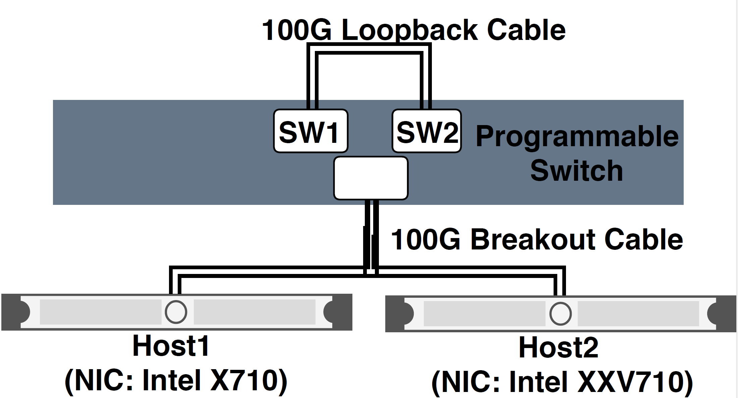
Measurement Setup
Notes:
To perform this measurement, we use a Barefoot Tofino switch, and two server with different intel NICs connected using 100G breakout cables.
Additionally, we connect the a 100G loopback cable to the switch, in order to emulate two virtual switches sharing the same ground-truth clock.

Slide 10
Switch -to-Switch Measurements

Slide 11
Send Request
SW1 : Client
Request Wire Delay
SW2 : Server
Embed Timings in packet
Time
Reply Wire Delay
SW1 : Client
Response Received
Analyze the timings
Notes:
The Switch1 creates a request packet and switch 2 embeds timing information in the packet sending out the response.
Once the response is received in the Switch1, the entire time-line is available to be analysed. Now, since both the switches belong to the same physical switch, the events are already ordered consistently.

Slide 12
Send Request
SW1 : Client
SW2 : Server
Time
SW1 : Client
Response Received
Analyze the timings

Slide 13
Idle Links 10G
Request Wire Delay
Send Request
67 – 79 ns
Mac & Parser
Receive Time
SW1 : Client
0 – 57 ns
Ingress Time
Ingress Pipeline
SW2 : Server
Time
Un-accounted
Queueing Engine
RTT
1462 – 1637 ns
AVG: 1473 ns
Egress Time
Egress Pipeline
Embed Timings in packet
296 – 365 ns
Deparser & Mac
64 – 77 ns
Transmit Time
SW1 : Client
Reply Wire Delay
Response Received
Analyze the timings
Notes:
We send over thousands of such packets to guage the delays.
Initially, we perform this experiment with idle links configured with speed of 10G.
We observe an RTT or 1.4 to 1.6 us for our p4 program. The interesting part is that the RTT varies by 100s of nanoseconds even undel idle link conditions.
We observed that most contributing part to this variation is deparsing & MAC delays
Ingress/ egress pipeline is a fixed stages and do not incur much variability.
In a general scenario, we can account for all this delays, except for the serialization & wire-delay, which cannot be captured.
We observe the serialization and wire-delay varies to about 10s of nanoseconds, and exhibits a asymmetry at nanosecond-level.

Slide 14
Cross Traffic : Linerate 10G
Request Wire Delay
Send Request
Mac & Parser
Receive Time
SW1 : Client
Ingress Time
Ingress Pipeline
SW2 : Server
Time
Queueing Engine
RTT
1460 – 1976 ns
AVG: 1667 ns
Egress Time
Egress Pipeline
Embed Timings in packet
298 – 803 ns
Deparser & Mac
Transmit Time
SW1 : Client
Reply Wire Delay
Response Received
UDP Traffic = 10G
Analyze the timings
Notes:
Next, we send UDP cross traffic at line-rate from the end-hosts in the link between SW2 and SW1.
We observe that with cross-traffic at line-rate there is the latency at deparser & MAC. We suspect, this could be due to queueing at the port buffers before serialization.

Slide 15
Cross Traffic : Oversubscribed
Request Wire Delay
Send Request
Mac & Parser
Receive Time
SW1 : Client
Ingress Time
Ingress Pipeline
SW2 : Server
Time
Queueing Engine
RTT
1.555 – 1.559 ms
AVG: 1.556 ms
1.552 – 1.556 ms
Egress Time
Egress Pipeline
Embed Timings in packet
1747 – 1914 ns
Deparser & Mac
Transmit Time
SW1 : Client
Reply Wire Delay
Response Received
Analyze the timings
UDP Traffic > 10G
Notes:
When we send oversubscribed traffic, more than the link-speed (10G), the cross traffic packets quickly fill up the queues. Thus, as expected the queuing time increases to about 1.5 millisecond.
Additionally, we also observe an increase in the MAC delay due to persistent queueing at the port queues.

Slide 16
Cross Traffic : Oversubscribed
Request Wire Delay
Send Request
Mac & Parser
Receive Time
SW1 : Client
Ingress Time
Ingress Pipeline
Priority Queueing
SW2 : Server
Time
Queueing Engine
Egress Time
Egress Pipeline
Embed Timings in packet
1747 – 1914 ns
Deparser & Mac
Transmit Time
SW1 : Client
Reply Wire Delay
Response Received
Analyze the timings
UDP Traffic > 10G
Notes:
When priority queueing is employed, we observe the queuing time is brought down. However, the queueing at deparser& mac is still present.

Slide 17
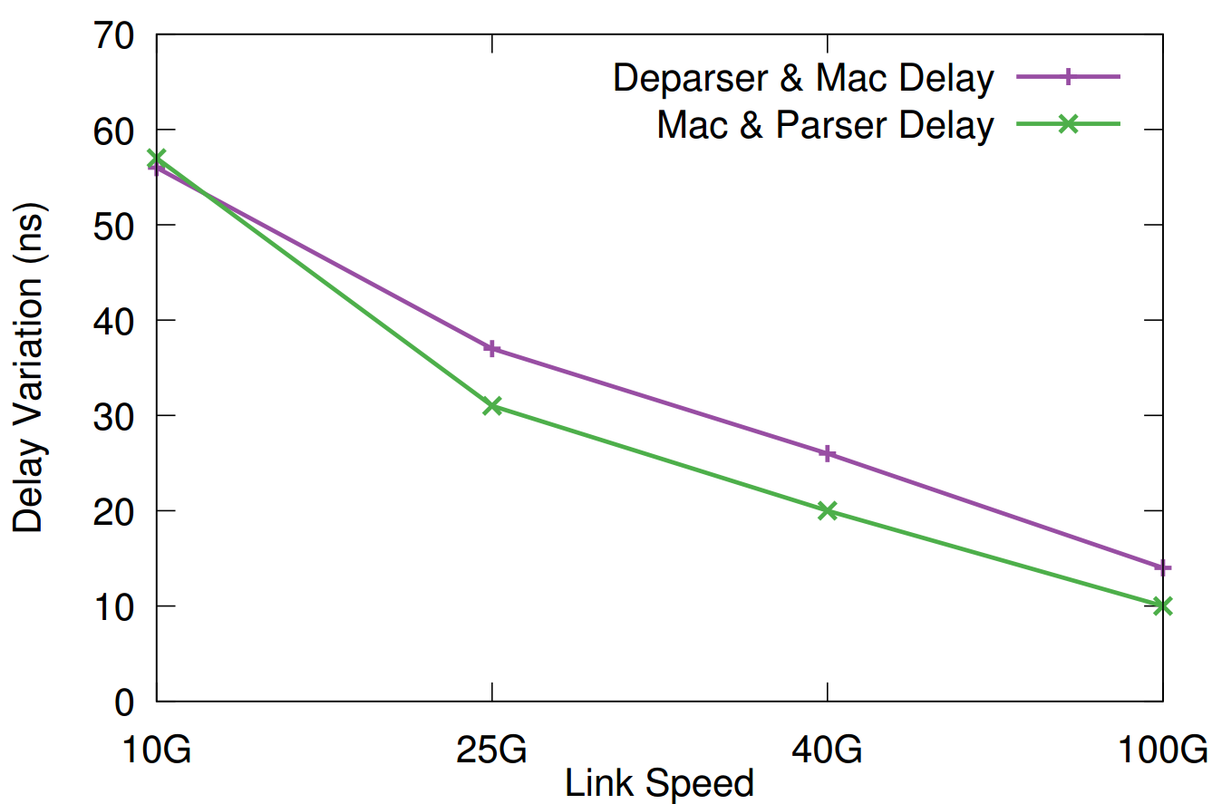
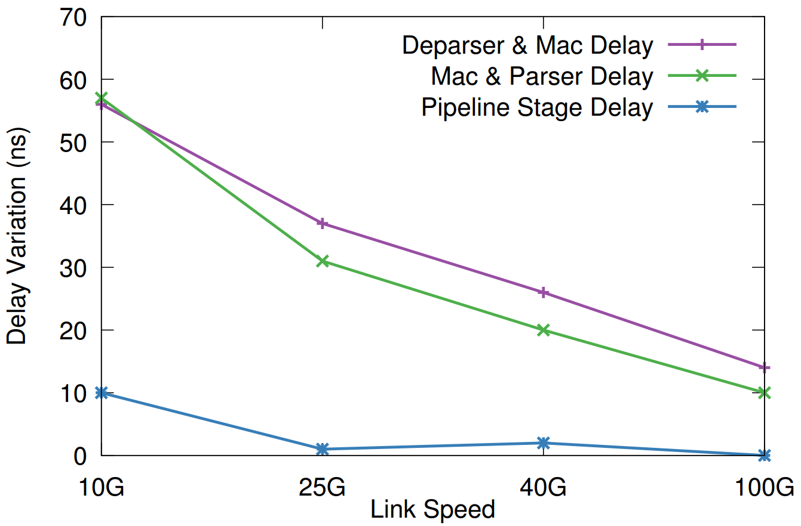
Variation of Accounted Delays at 10/25/40/100G
Decrease in variation of Serialization delays
Notes:
Next, we observe the variation of these Accounted delays with higher link speeds,
We observe a drastic reduction in mac & parser delays at higher link speeds.
Pipeline stage delay also reduces at higher links speeds although the variation is small to begin with.

Slide 18
Un-accounted Delay – Wire Delay Asymmetry
Decrease in Wire-delay asymmetry with higher speeds
Notes:
Next, we focus on the un-accounted delay, the wiredelay.
We plot the difference between the mod of wire-delay for a request and response packet. We call this value as wire delay asymmetry in y axis.
we observe at 10G, the wire-delay variation is 13ns, and reduces to 7ns at 100G.
This value gives us an upper-bound on the synchronization error that could be achieved between two switches, since the wire-delays are the only un-accounted delays.
This suggests that it is possible to achieve better synchronization with higher speeds.

Slide 19
Switch -to-Switch Measurements
Take-aways :
At nanosecond-scale, even idle link conditions show variability of 100’s ns.
It is possible to account various delay components in switching with PSA.
The only un-accounted delay is Wire-delay.
At nanosecond-scale, Wire-delay exhibits asymmetry.
Asymmetry reduces with higher link-speeds.
Notes:
Hence, the key take-aways from the switch to switch measurements are that :
At nanosecond scale, under idle conditions, the variability of few 100 ns is observed. However, It is now possible to account for various delay components in the network.
The only un-accounted delay is the wire-delay and importantly at nanosecond-scale it exhibits asymmetry.
However, the asymmetry reduces with higher link speeds.

Slide 20
Switch-to-Host Measurements
Notes:
Next, we move on to switch-to-host measurements.
Where the end-host is the client, and the next-hop switch acts like the server and responds to timesync requests.

Slide 21
Send Request
Host : Client
Request Wire Delay
SW : Server
Embed Timings in packet
Time
Reply Wire Delay
Host: Client
Response Received
Notes:
To perform the measurements, we leverage the NIC hardware timestamping available in the NICs to provide accurate timestamps upon packet reception & departure at host.
The request packet is initiated by the client, and the requests is received by the switch which adds in the delays in the packets and is sent back to the host for analysis.

Slide 22
Idle Links SFP+ (10G)
Send Request
Host : Client
Request Wire Delay
SW : Server
Time
Un-accounted
402 – 429 ns
645 – 666 ns
NicWireDelay
RTT
1059 – 1084 ns
Reply Wire Delay
Host: Client
Response Received
Notes:
Under idle link conditions,
We observe the rtt is aroind 1 microsecond. We observe that the aggregate delay at the switch is only around 650 ns.
However, around 400 ns of delays cannot be accounted for, and it could be attributed to the SFP+ latency. We call this delay as NicWireDelay.

Slide 23
Upstream Cross Traffic(10G)
Send Request
UDP Traffic (1 – 10G)
Host : Client
Request Wire Delay
SW : Server
Time
Un-accounted
625 – 699 ns
645 – 666 ns
NicWireDelay
RTT
1280 – 1354 ns
Reply Wire Delay
Host: Client
Response Received
Notes:
However, When we infuse cross traffic along with the request packets from the server, interestingly, we observe an increase in the NicWireDelay.

Slide 24
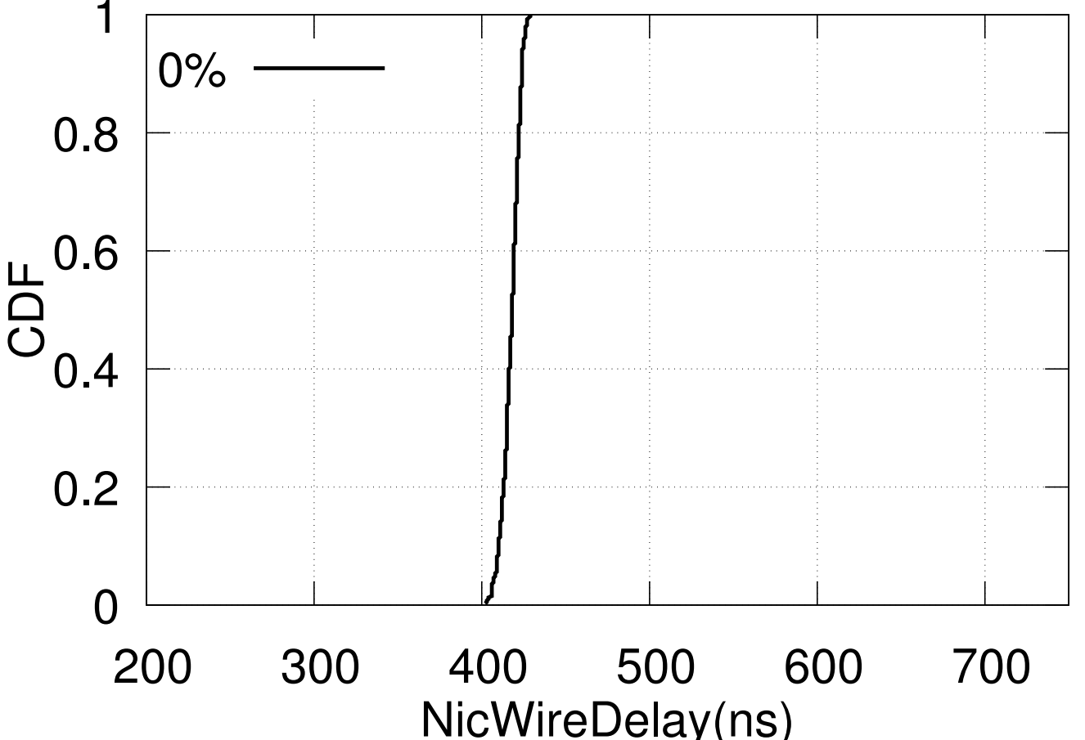
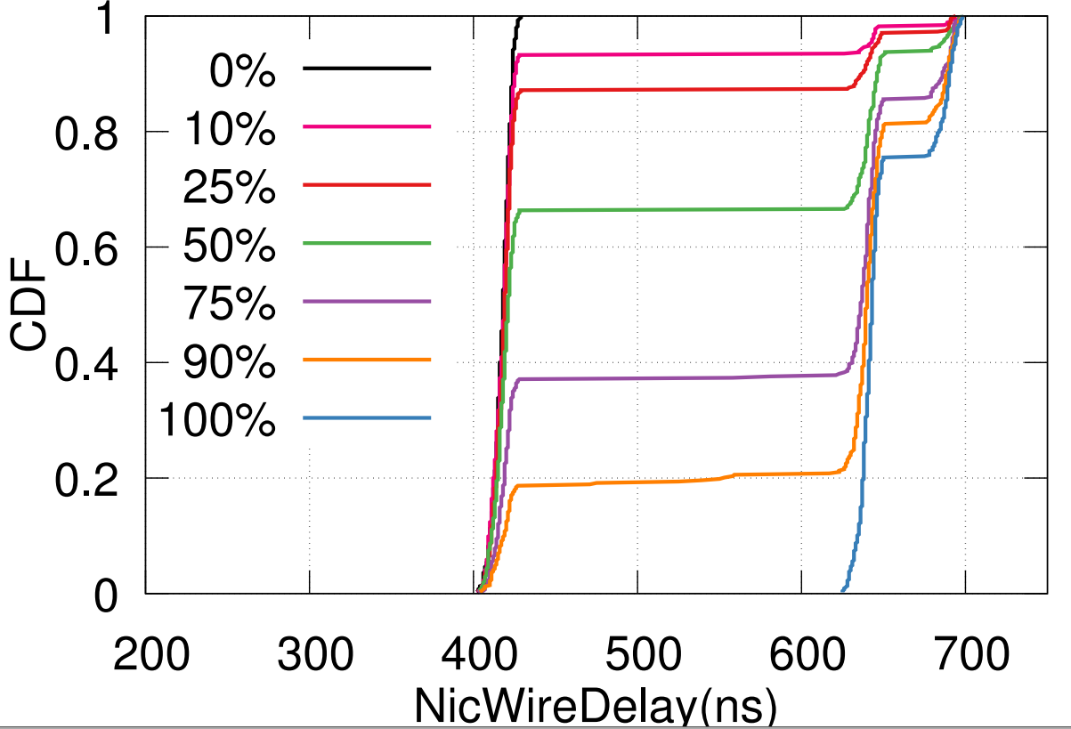
The Case of NicWireDelay
300 ns
Notes:
To understand about the nicwiredelay, we plot the CDF of the nicwiredelay observed for different traffic rates.
Interestingly, the variation occurs at as low as 10% traffic rate and is upto 300 ns
We oberve similar trend in two different NICs

Slide 25
Switch-to-Host Measurements
Take-aways :
In spite of Nic hardware Timestamping, there is an un-accounted and variable delay (NicWireDelay).
NicWireDelay varies from 27 ns under idle conditions up to ~300 ns under heavy cross traffic conditions.
To tackle this variability at Switch-to-Host, it is ideal for host to have knowledge of cross-traffic volume on the send direction.
Notes:
Hence, the takeaways from switch-to-host measurements are that:
In spite of Nic hardware timestamping there is a huge amount of unaccounted and variable delay which we call nicwiredelay.
This delay varies as less as 27ns under idle condition to upto 250 ns under heavy cross traffic conditions.
To design a synchronization protocol to handle this variation on cross-traffic, it is ideal for host to have a knowledge of cross-traffic volume being transmitted from the host port.

Slide 26
DPTP
Data Plane Time-synchronization Protocol
Notes:
With the key insights from the measurements,
I will move on to explaining the key concepts of DPTP (Data plane Timesynchronization Protocol)

Slide 27
DPTP Design
Notes:
In tDPTP, we design the network to be master clock.

Slide 28
DPTP Design
Master Switch
Notes:
A master switch designated by the operator is initiated using an external clock reference.
A network-level DAG is formed to propagate time-synchronization between individual nodes on a single-hop basis.
We now move on to what happens in the master-switch.

Slide 29
Master-clock Initiation
T_{Ext} (External Clock Ref)
Master Switch
1) T_{Ref} = T_{Ext}
2) T_{offset} = T_{Ig}
Snapshot Time at Ingress as offset time
Notes:
The master switch stores this external time as Reference Time (Tref) in its registers, and takes a snapshots of its current data-plane timestamp as the offset time

Slide 30
Era Maintenance
Switch Dataplane Clock (T_{Ig}/T_{Eg}) is 42/48-bit counter
Wraps around after 78 Hours
1) T_{Ref} = T_{Ext}
2) T_{offset} = T_{Ig}
1) T_{Ref}
2) T_{offset}
3) T_{Era}
Notes:
However, the switch dataplane clock is limited to only 42/48 bits. Hence, we need to maintain an Era register to be incremented upon wrap around.

Slide 31
Switch Time-keeping
Elapsed Time
T_{Now} = T_{Ref} + (T_{Ig} - T_{offset}) + T_{Era}
1) T_{Ref}
2) T_{offset}
3) T_{Era}
1) T_{Ref} = T_{Ext}
2) T_{offset} = T_{Ig}
Notes:
To maintain the current global time at the switch, an ALU operation in the data-plane (reference, elapsed and era) on demand.

Slide 32
DPTP Design
Master Switch
ToR Switch
Notes:
Now, we move on to synchronization between the master switch and tor switch

Slide 33
DPTP Design
Master Switch
ToR Switch

Slide 34
DPTP Switch-to-Switch Request Response
ToR Switch
Initiate DPTP Request
Master Switch
Calculate T_{Now}
DPTP Reply
{T_{Now}, Egress Time, Rx Time}
Follow-up
{Tx Time}
ToR Switch
Reference Adjustment
T_{Ref} = T_{Now} + RespDelay (Calculated using individual Delays)
Notes:
Upon the request from tor switch , master switch, calculates the current time Tnow, and sends along the time of reception, and time at egress which comprises queueing.
Additionally, it has to send a follow-up packet, which actually contains the time when the packet was sent out of the port, since its not possible to embed this information when the packet is being transmitted.
With this information, the tor switch can easily calculate the reference time by estimated the response delay with the given timing information

Slide 35
DPTP Design
Master Switch
ToR Switch
End-Host
Notes:
Each switch in the network will synchronize with its neighboring switch, and the global time will be maintained in the network dataplane.
Now, when a host needs the time, a Top of the Rack switch can respond quickly, and host can synchronize with the network time.

Slide 36
DPTP Design
Master Switch
ToR Switch
End-Host

Slide 37
DPTP Switch-to-Host Request Response
End-Host
Initiate DPTP Request
Phase 1: Profiling
No Cross-Traffic
ToR Switch
DPTP Reply
{T_{Now}, Egress Time, RxTime,
Traffic Rate}
Follow-up
{Tx Time}
End-Host
NicWireDelay Profile
Notes:
In the case of DPTP request response from host to switch, the main difference is that we follow a two phase approach.
Phase 1 is a one-time profiling (probably upon the server boot-up of nic initialization) when the server sends out few requests/response when there is no cross traffic coming from the server.
This profiling is used to calculate the baseline nicwiredelay , which gives an approximate one-way delay estimate.

Slide 38
DPTP Switch-to-Host Request Response
End-Host
Initiate DPTP Request
Phase 2:
Synchronization
ToR Switch
Calculate T_{Now}
DPTP Reply
{T_{Now}, Egress Time, RxTime,
Traffic Rate}
Follow-up
{Tx Time}
End-Host
Reference Adjustment
T_{Ref} = T_{Now} + RespDelay
NicWireDelay/2 ; if TrafficRate ≈ 0%
Profiled NicWireDelay/2 ; Otherwise
Notes:
The 2nd phase is the actual synchronization phase, where the time synchronization happens.
Only difference in the switch response is that, along with the time, the switch also sends the incoming traffic rate from the host.
If the traffic rate is close to 0, the nicwiredelay of the current cycle is used. In the presence of cross traffic, the profiled nicwiredelay is used to correct the skewed one-way delays.

Slide 39
DPTP Design Summary
Master Switch
Challenge 1 : Variable / Unaccountable Network Delays
Solution :
Use the Precise Timestamps to account variable delays.
Close to accurate estimate of one-way delays at NICs using profiling.
Notes:
To summarize the DPTP design principles in terms of challenges in time synchronization.
DPTP solves the variable network delay challenge by using precise timestamps available in PSA and profiling the delays in NIC.

Slide 40
DPTP Design Summary
Master Switch
Challenge 2 : CPU Scheduling Delays
Solution :
Maintain the Clock in data-plane.
Notes:
To avoid CPU scheduling delays, the clock is maintained in the predictable network data-plane

Slide 41
DPTP Design Summary
Master Switch
Challenge 3 : Clock Drifts
Solution :
Continuous DPTP synchronization.
Sub-RTT Response (Adjacent nodes).
Notes:
To handle clock-drifts, there is continuous synchronization between the pair of nodes
And since this is only one-hop, the req-response in Sub-RTT compared to two end-hosts.

Slide 42
DPTP Implementation
Barefoot Tofino Switch (Wedge100BF-32X)
Data-Plane
900 lines on P4 code
Control-Plane
500 lines of C code
DPTP request generation
DPTP follow-up packet handler
Era Maintenance
NIC client
MoonGen wrapper over Intel DPDK
Crafting and handling (Tx/Rx) custom packets
while bypassing the kernel
Notes:
We implement DPTP on the barefoot Tofino switch with over 900 lines of p4 code in the data-plane. Additionally, we write control plane program in C for request packet genenration, follow-up handlers and era maintenance thread.
On the host, we use Moongen over intel DPDK to craft custom packets at line-rate bypassing the kernel.

Slide 43
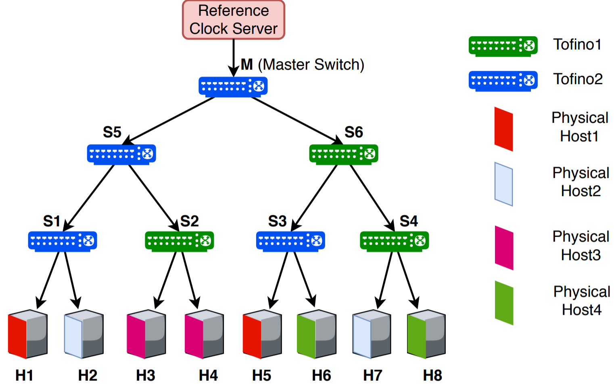
Evaluation
Continuous
DPTP 500pkt/sec
Notes:
We evaluate DPTP over a logical tree topology made using two barefoot Tofino switches, and four physical servers. We emulate the logical switches using loopback cables and inter-switch cables.
The logical hosts are VMs on top of the physical server.
Throughout our evaluation, we use a 500 DPTP packets/sec to continuously synchronize the nodes.

Slide 44
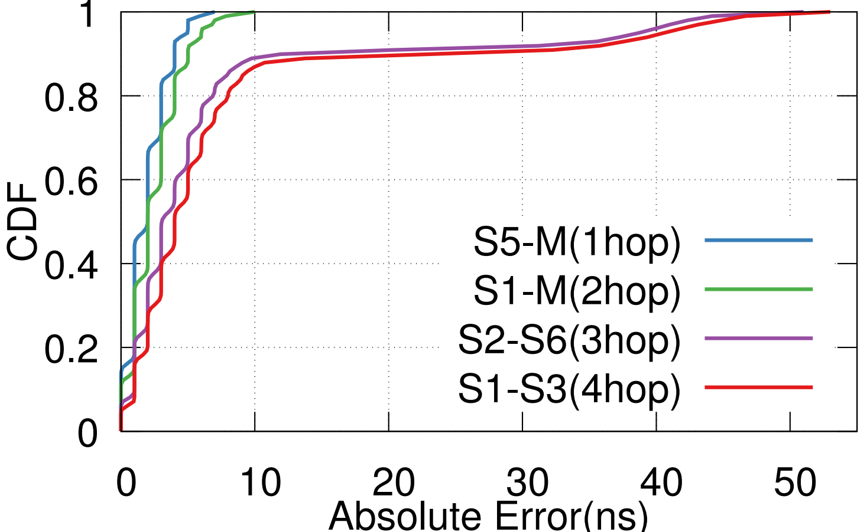
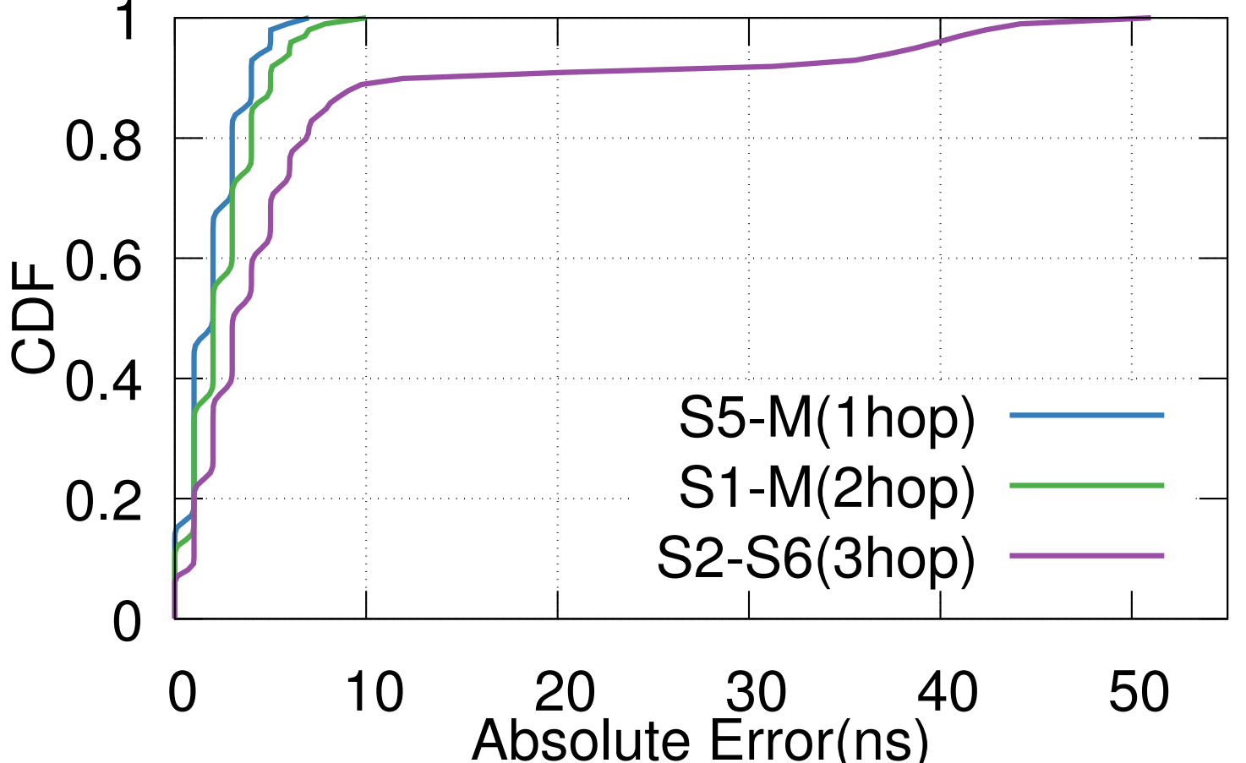
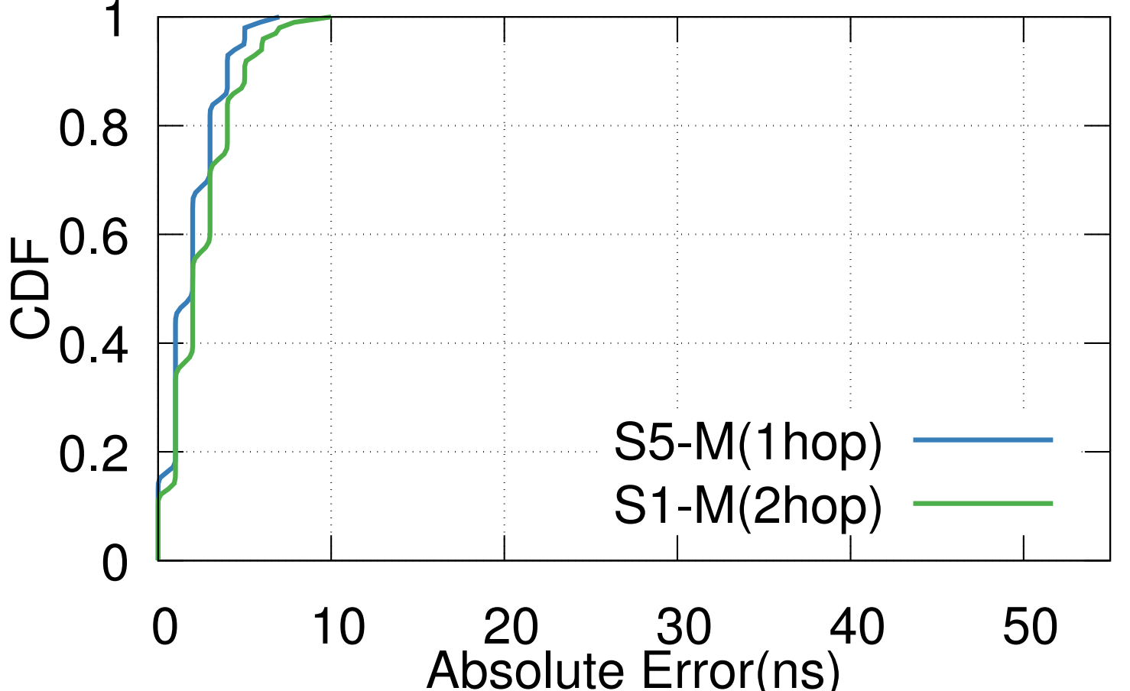
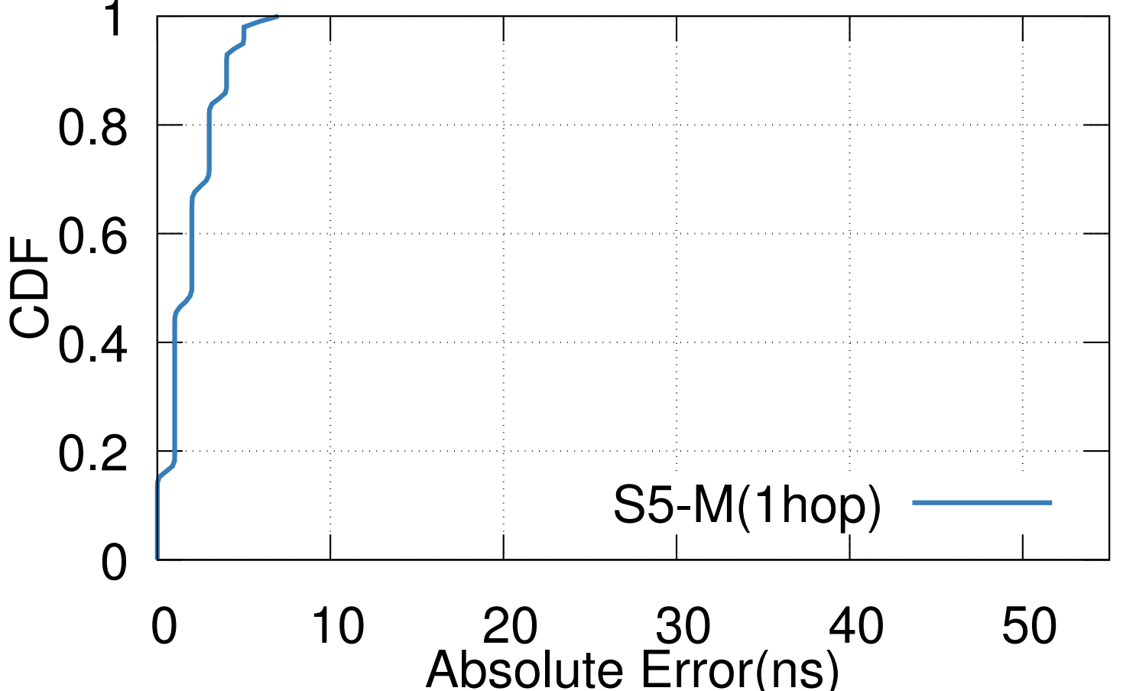
Switch-to-Switch Synchronization Error
Idle Condition
Notes:
We shall look into synchronization error between pair of switches over the network under idle condition.
We observer the error is bounded by 6ns for a single hop, and 10ns for switches separated by 2 hops.
In case of error between s2 and s6, and s1-s3, where the synchronization cross actual switch boundaries, we observe an long tail. This is because of drift between the clocks of the physical switches

Slide 45
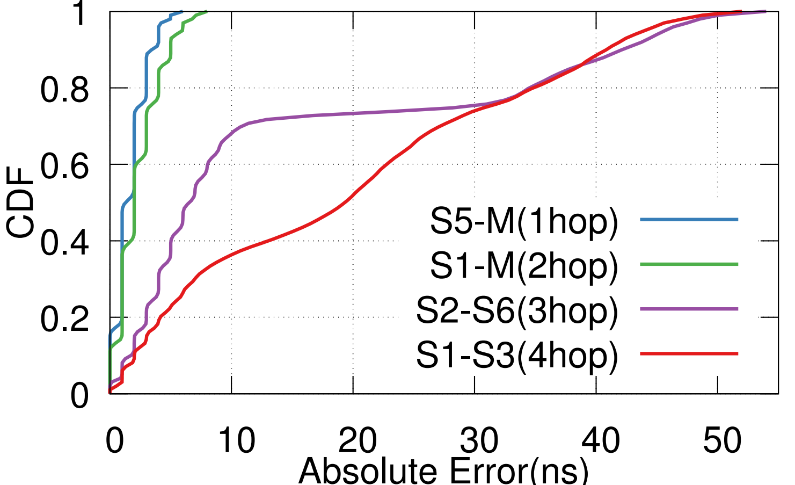
Switch-to-Switch Synchronization Error
Idle Condition
Heavy Cross Traffic
Notes:
Under heavy cross traffic, for S5-M, and S1-M do not see much effect, since we account for all the delays of queueing in the synchronization.
However, we observe an increase in median error for S2-S6 and S1-S3 since the drift increases with delay in message arrivals.
Overall, we observe the 99th percentile to be 47ns and median of 20 ns even under bursty network conditions.

Slide 46
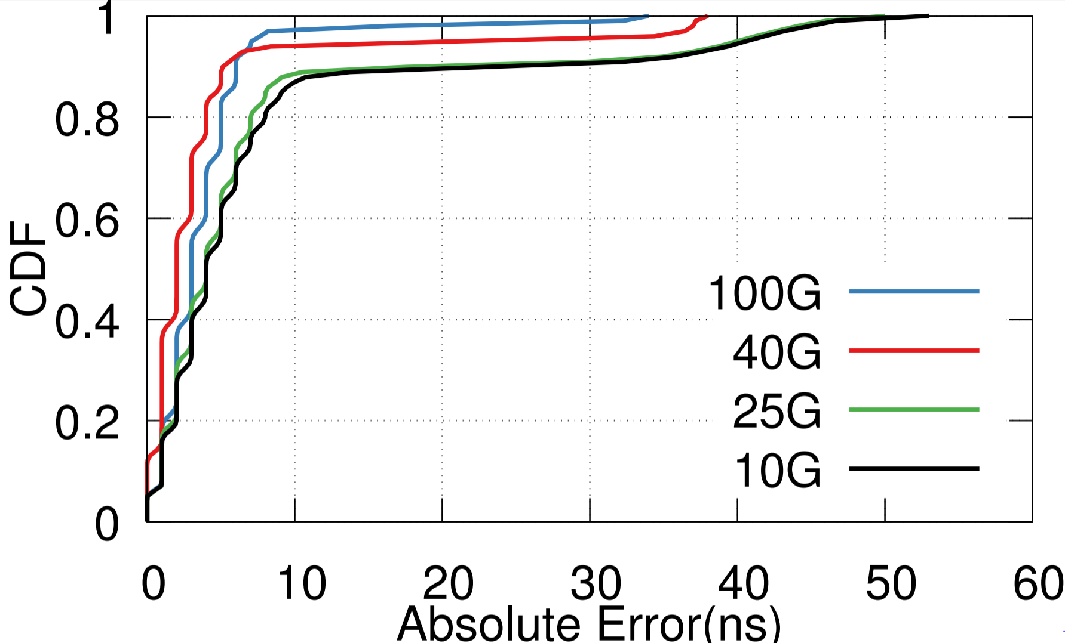
Switch-to-Switch Synchronization Error (Different Links Speeds)
Idle Condition (4 Hops)
Notes:
With higher link speeds, as expected during our measurement results, we observe reduction sycnrhonization error between the switches 4 hops apart and across physical switch boundaries

Slide 47
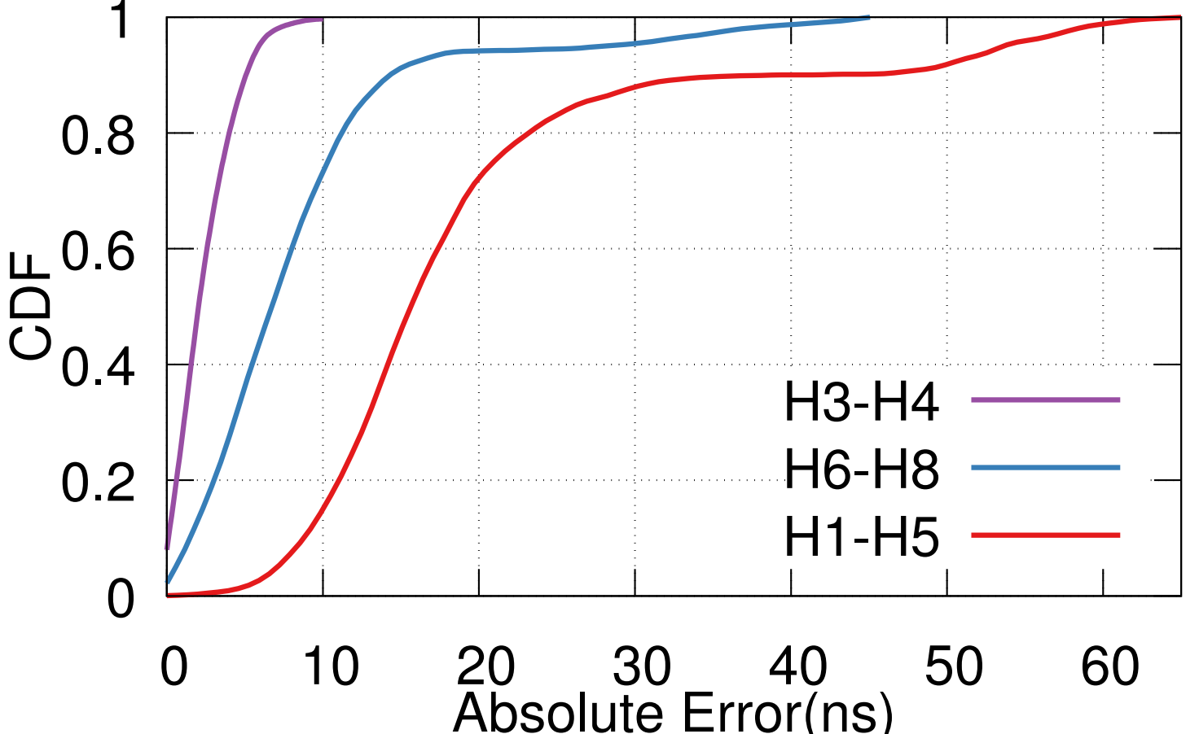
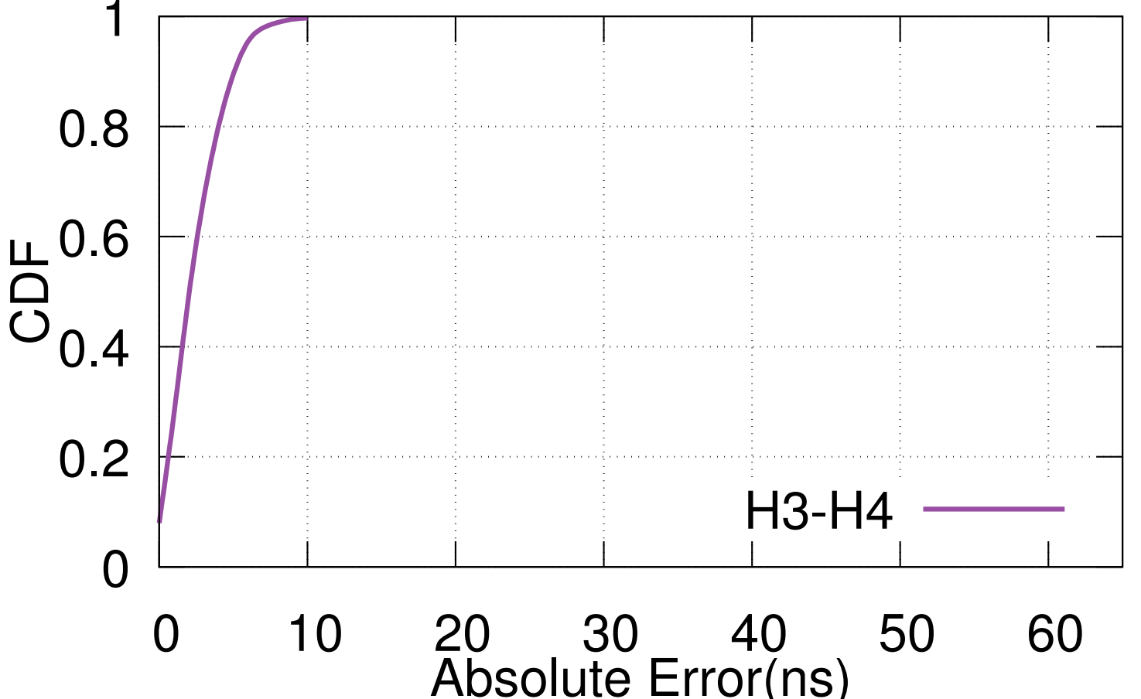
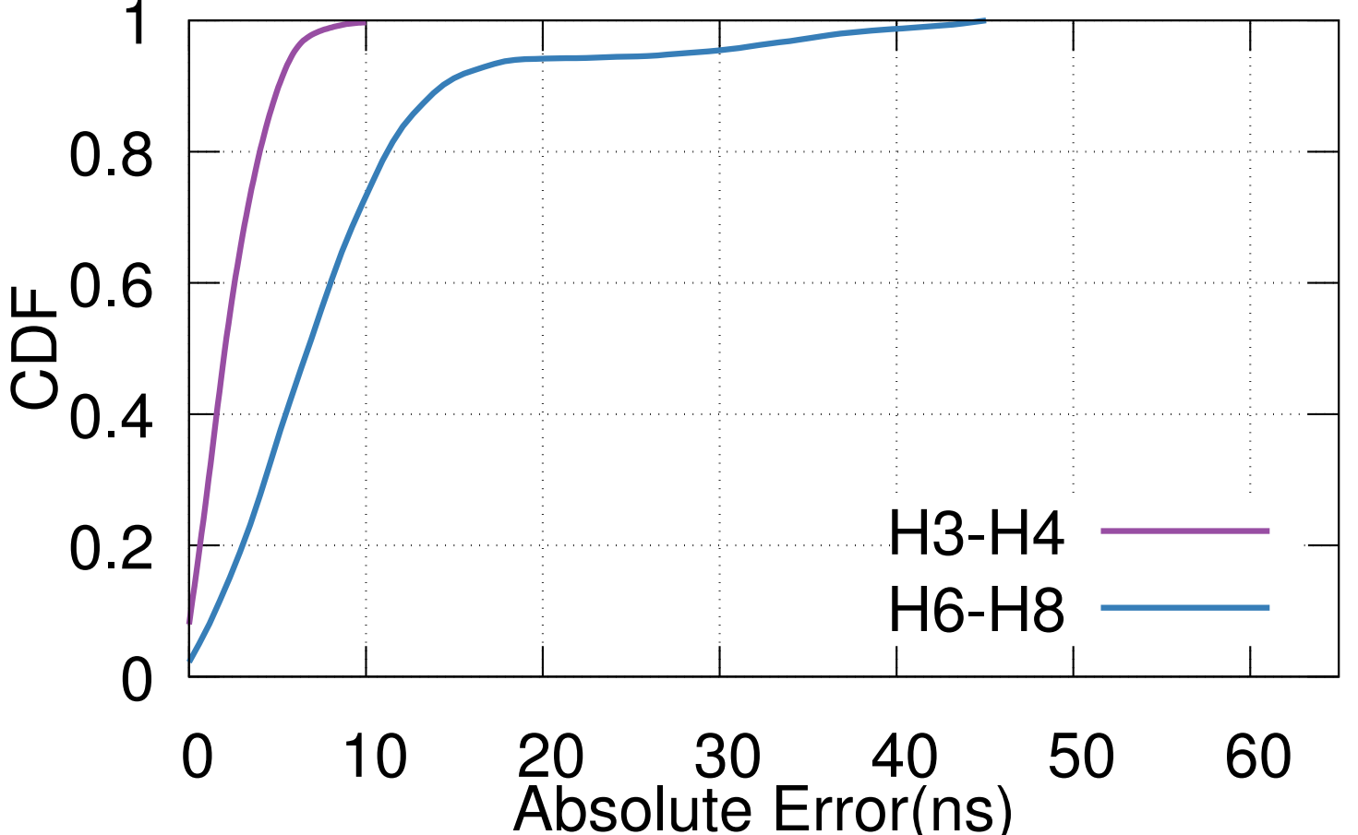
Switch-to-Host Synchronization Error
Idle Condition
Notes:
Now, we look into the synchronization error between the hosts. Between hosts H3,H4 which obtain the timing from the same switch S2, we observe maximum error of 10ns and a median of 4ns.
Between hosts that obtain time from different physical switches, we observe an increase in error with 99th percentile of 50ns and median of 15ns.

Slide 48
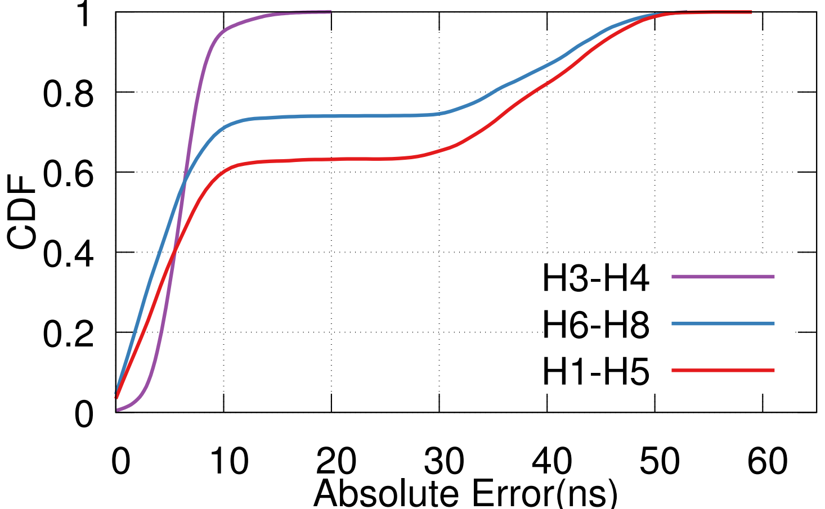
Switch-to-Host Synchronization Error
Idle Condition
Heavy Cross Traffic
Notes:
Under heavy cross traffic condition, We observe a slight increase in the median error for all the cases since DPTP uses the profiled NICwiredelay to calculate the one way delay.
However, the 99th percentile error is still bounded by 50ns.

Slide 49
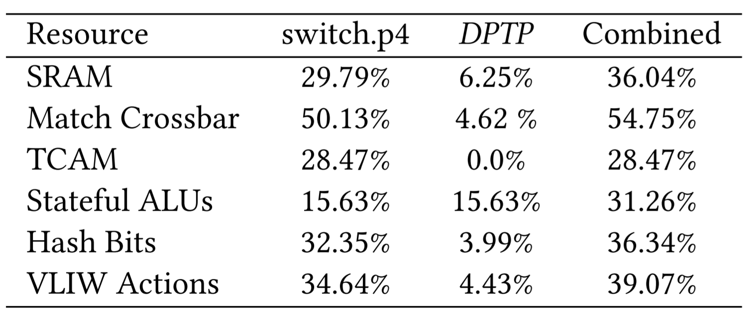
Resource Usage
Bandwidth
3.07 Mbps per pair (or link) for 2000 DPTP requests/sec.
8 times lesser compared to HUYGENS[NSDI’18].
Switch Resources
Notes:
DPTP consumes on 3Mbps bandwidth per link in the network for 2000 DPTP reqs/sec and easily scales with the size of the network.
This is about 8 times lesser compared to HUYGENS.
Finally, DPTP can be easily fit into the PSA architecture along with switch.p4, and still have enough resources for other applications to be implemented.

Slide 50
Conclusion
Measurement of variable delays in the path.
DPTP is designed to account for the variable delays in the switching.
DPTP enables synchronization between switches and hosts in network to within 10s of nanoseconds.
DPTP can enable interesting distributed applications (in-network computing) to be developed for the network dataplane.
Notes:
So, to summarize.
We perform extensive measurement of variable delays in the network during synchronization. We design and implement DPTP based on key insights from the measurements, and hence it is able to achieve synchronization to within 10s of nanoseconds.
Finally, tightly time synchronized network dataplane, can enable speedy distributed applications to be developed in the network dataplane. And we hope DPTP can help in that cause
Thank you for your attention, I am open for questions.s

Slide 51
Thank You

